Slide 1
AI Alzheimer and Dementia Review
Gavriilidis Paraskevas

Slide 2
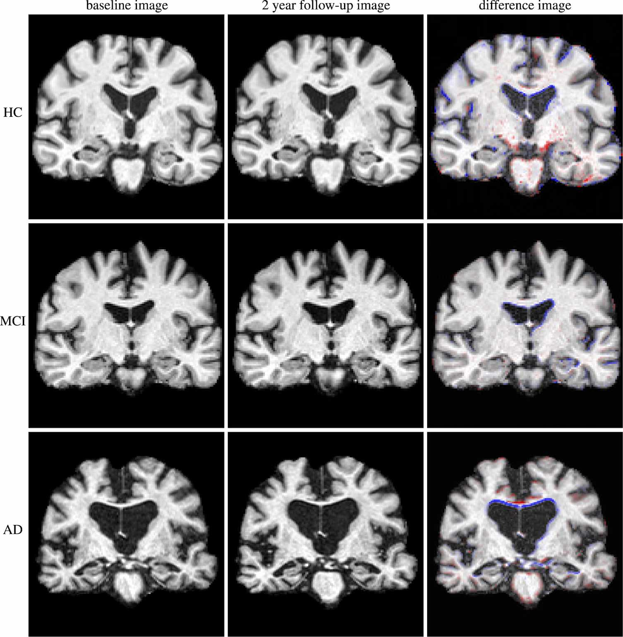
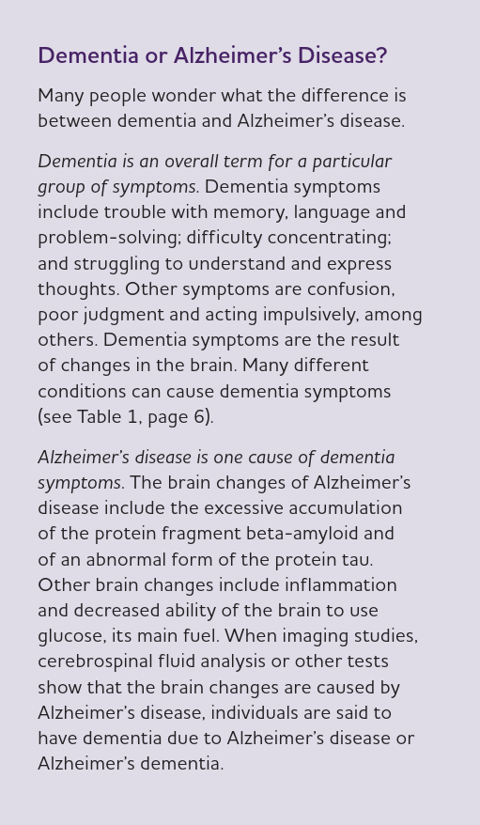
Overview of Alzheimer & Dementia
Healthy control
Mild Cognitive Impairment
Alzheimer Disease
Ledig, C., Schuh, A., Guerrero, R. et al. Structural brain imaging in Alzheimer’s disease and mild cognitive impairment: biomarker analysis and shared morphometry database. Sci Rep 8, 11258 (2018). https://doi.org/10.1038/s41598-018-29295-9
Alzheimer's Association. (2025). 2025 Alzheimer's disease facts and figures. Alzheimer's & Dementia

Slide 3
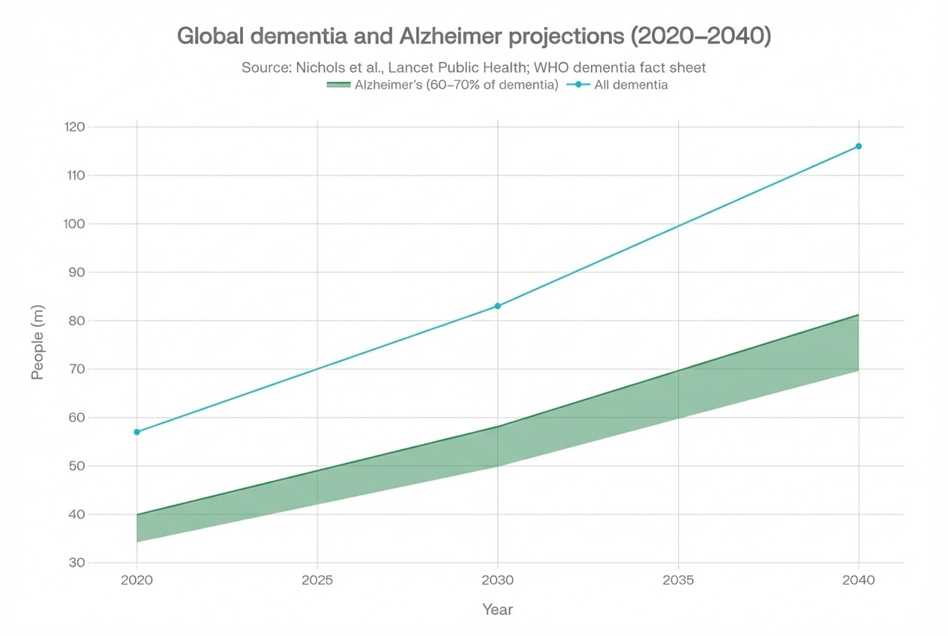
Affected Population
Global dementia cases are projected to increase from 57 million in 2020 to 83 million by 2030 and 116 million by 2040, with Alzheimer's disease accounting for approximately 60–70% of all cases.
E. Nichols et al., "Estimation of the global prevalence of dementia in 2019 and forecasted prevalence in 2050: an analysis for the Global Burden of Disease Study 2019," Lancet Public Health, vol. 7, no. 2, pp. e105-e125, Feb. 2022, doi: 10.1016/S2468-2667(21)00249-8.
World Health Organization (WHO). Dementia – Fact sheet, updated 30 March 2025. Available at: https://www.who.int/news-room/fact-sheets/detail/dementia

Slide 4
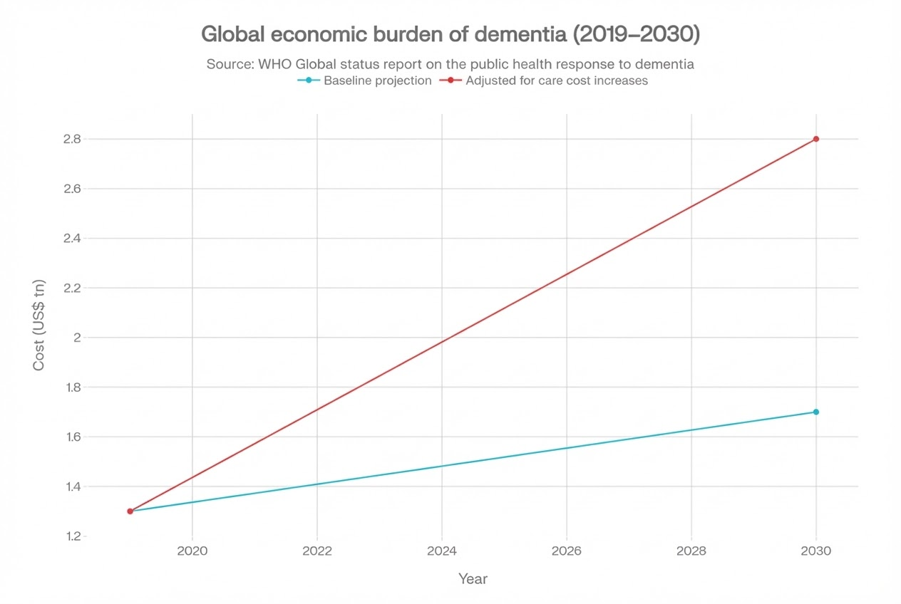
Economical Impact
The global economic cost of dementia was $1.3 trillion in 2019 and is projected to reach $1.7 trillion by 2030 under baseline assumptions, or $2.8 trillion when accounting for rising care costs.
World Health Organization. (2021). Global status report on the public health response to dementia. Geneva: World Health Organization.

